Slide 1

Gridiron Tactical
Fixed Income
Prepared For:
Allegheny County Employees' Retirement
August 2025

Slide 2

GRIDIRON TACTICAL FIXED INCOME
Gridiron Tactical Fixed Income is designed to produce high current income and capital growth while not taking on excess credit and duration risk. The strategy invests opportunistically through the use of publicly traded fixed income closed-end funds.
What is a closed-end fund?
The fund raises capital primarily through an initial public offering (IPO).
After the IPO, closed-end funds are listed on a national exchange such as the New York Stock Exchange (NYSE)
A closed-end fund holds a diverse selection of securities. These securities collectively add up to a value, known as its Net Asset Value (NAV).
The market price of a closed-end fund is determined by market demand and supply, not the fund's net asset value.
2

Slide 3
CEF vs MUTUAL FUND(Open End Fund) vs ETF
 | Closed-end Fund | Mutual Fund - Open-end Fund | ETF – Exchange Traded Fund
Share Structure | Fixed Number of Shares | Unlimited Number of Shares | Unlimited Number of Shares
Trading | Market Price | Net Asset Value | Market Price
NAV vs Price | Discount/Premium | Equilibrium | Equilibrium
3

Slide 4
INVESTMENT UNIVERSE
Closed-end Fund Universe
Gridiron Partners Tactical Fixed Income invests exclusively in fixed income closed end funds
SECTORS
Diversified
Mortgage Backed
Corp High Yield
Low Duration
Preferred
Convertible
Floating Rate
Global
Municipal
175
FIXED
INCOME
FUNDS
TOTAL UNIVERSE
550
FUNDS
AUM > $100
440
FUNDS
ACTIVELY TRADED
275
FUNDS
4
4

Slide 5



TRADE EXAMPLE
Calamos Convertible Opportunities and Income Fund (CHI)
11/12/2015 Purchase: Convertibles sold off in late 2015 due to the decline in oil prices/equity market. Gridiron saw Convertibles as a way to play the potential rebound in oil with downside protection. CHI was the most attractive CEF trading at a 12% Discount to NAV, more than 700bps greater than our estimate of fair value. We saw the potential for both NAV appreciation as well as discount narrowing.
2/8/2017 Sale: Convertibles rallied with the subsequent rise in oil prices. CHI gained more than 23% from our purchase and traded at just a 1% Discount to NAV. Gridiron saw both the risk/reward in the convertible market as well as CHI as unfavorable with oil prices stalling and a lack of margin of safety in the discount.
11/12/2015
Average Purchase Price: $10.01
Discount to NAV: 12%
Total Return 24.40%
2/8/2017
Sale Price: $11.17
Discount to NAV: 1.0%

Slide 6
ADVANTAGES OF CLOSED-END FUNDS
Shares can be bought at deep discounts to NAV
Higher yields compared to open-end funds
Stable capital base
Limited capacity prevents large investment managers from accessing CEFs
6

Slide 7
SECTOR DISCOUNTS
August 2025
Diversified
Historical Avg Discount
-374.15%
Current Avg Discount
-362.82%
Corp/HY
Historical Avg Discount
-487.56%
Current Avg Discount
-650.38%
7

Slide 8
SECTOR DISCOUNTS
Preferreds
Historical Avg Discount
-612.41%
Current Avg Discount
-799.69%
Floating Rate
Historical Avg Discount
-633.91%
Current Avg Discount
-673.46%
8

Slide 9
SECTOR DISCOUNTS
Municipals
Historical Avg Discount
-532.29%
Current Avg Discount
-387.75%
MBB
Historical Avg Discount
-400.98%
Current Avg Discount
-205.25%
9

Slide 10
SECTOR DISCOUNTS
Low Duration
Historical Avg Discount
-360.71%
Current Avg Discount
-293.73%
Convertibles
Historical Avg Discount
-448.50%
Current Avg Discount
-571.86%
10

Slide 11
SECTOR DISCOUNTS
Foreign
Historical Avg Discount
-583.64%
Current Avg Discount
-783.92%
11

Slide 12
ASSET ALLOCATION
Sector Allocation
 |  | Aug 2025 | Aug 2024 | Sept 2023 | Aug 2022 | Aug 2021 | May 2020 | Apr 2019 | Sep 2018
SECTOR
Diversified |  | 2.56% | 2.58% | 5.59% | 13.33% | 2.57% | 3.35% | 1.15% | 1.22%
Corp/High Yield |  | 0.00% | 0.00% | 0.00% | 0.00% | 0.00% | 0.00% | 5.60% | 5.92%
Preferreds |  | 2.48% | 2.42% | 2.41% | 1.97% | 0.00% | 0.00% | 4.92% | 2.24%
Floating Rate |  | 0.49% | 0.47% | 1.75% | 3.42% | 12.35% | 27.48% | 4.72% | 4.46%
Municipals |  | 22.93% | 27.99% | 26.48% | 9.47% | 12.20% | 33.54% | 36.81% | 36.76%
MBB |  | 0.00% | 0.00% | 0.00% | 0.00% | 0.00% | 0.00% | 0.00% | 0.00%
Low Duration |  | 0.16% | 0.17% | 0.17% | 0.24% | 0.93% | 4.55% | 6.00% | 6.43%
Convertibles |  | 1.74% | 1.65% | 2.61% | 2.36% | 3.88% | 1.17% | 0.00% | 0.00%
Foreign/Emerging Markets |  | 0.82% | 0.86% | 1.32% | 1.97% | 3.47% | 3.20% | 12.06% | 12.57%
Indexes |  | 44.78% | 46.52 | 35.18% | 37.86% | 40.19% | 16.59% | 0.00% | 0.00%
Inverse ETFS |  | 0.00% | 0.00% | 0.00% | 2.97% | 3.01% | 4.84% | 12.72% | 14.19%
Cash |  | 24.05% | 17.34% | 24.48% | 26.43% | 21.42% | 5.29% | 16.00% | 15.56%
The financial information and performance data contained in this report represents unaudited financial information and may be subject to future adjustment and revision. Past performance is not a guarantee of future performance.
12

Slide 13
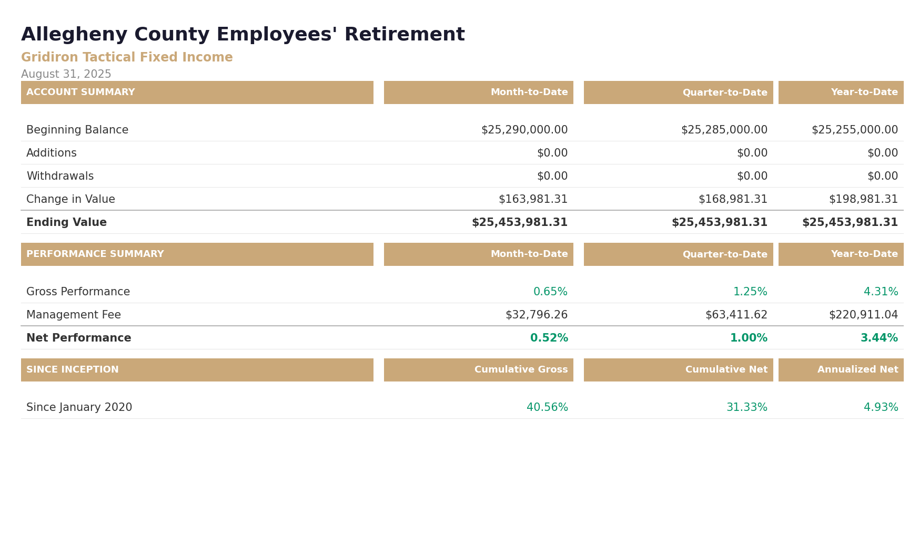
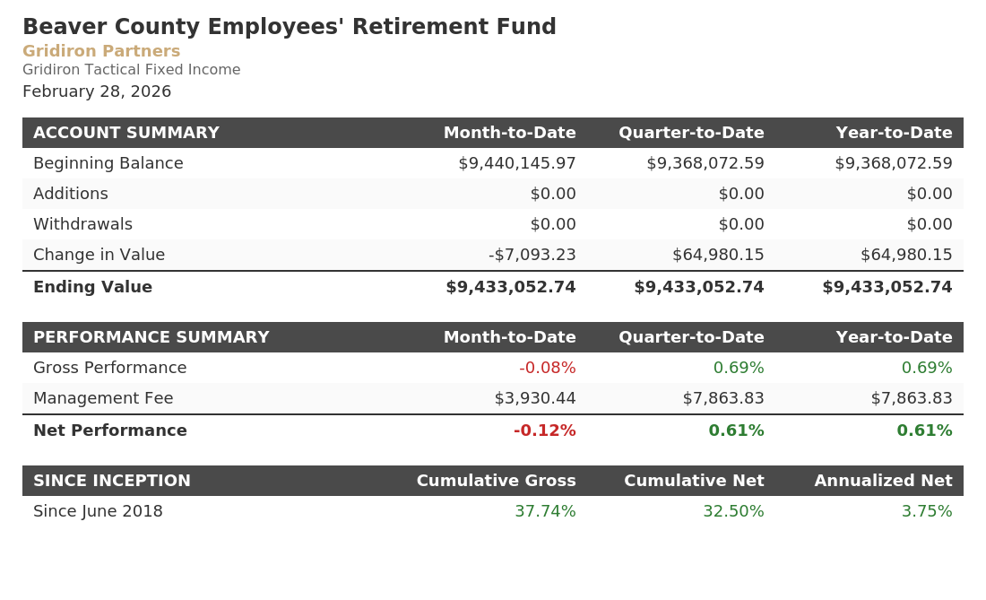
PERFORMANCE STATEMENT
August 2025
The financial information and performance data contained in this report represents unaudited financial information and may be subject to future adjustment and revision. Past performance is not a guarantee of future performance.
13

Slide 14
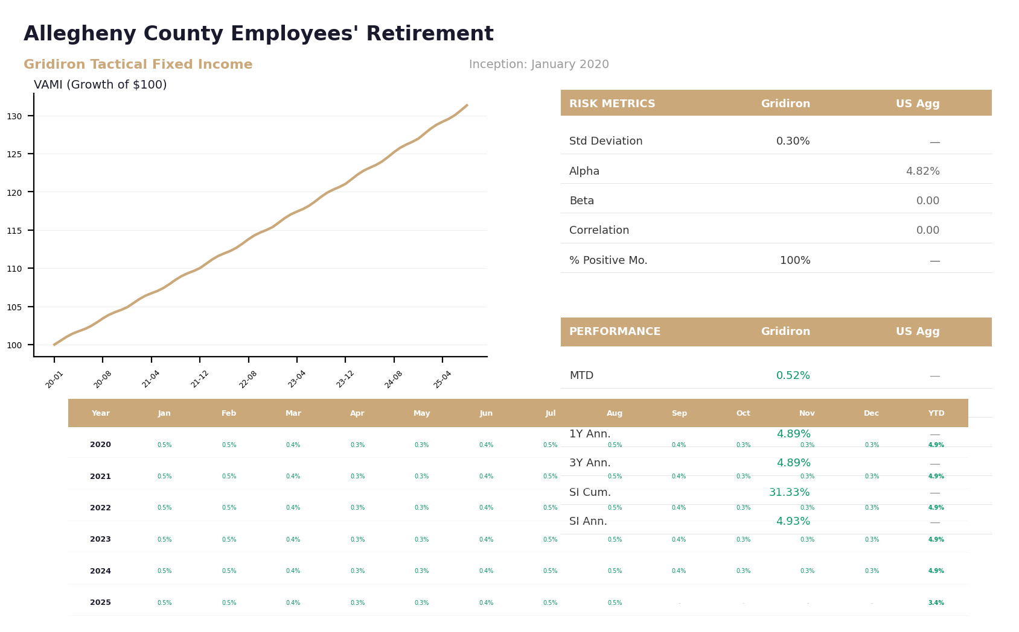
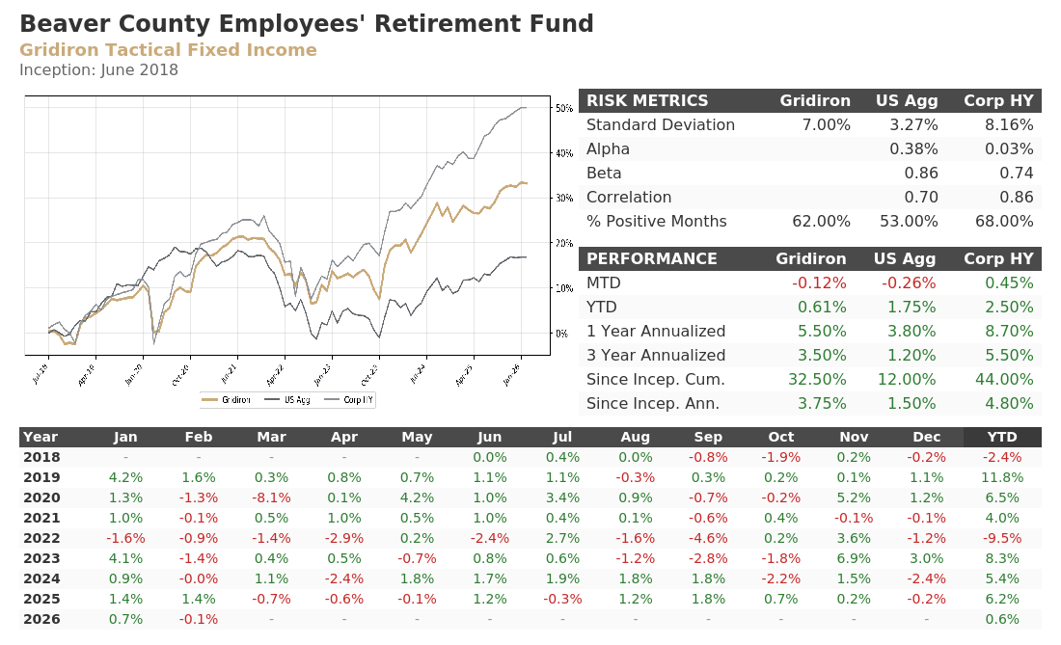
FACT SHEET
August 2025
The financial information and performance data contained in this report represents unaudited financial information and may be subject to future adjustment and revision. Past performance is not a guarantee of future performance.
14

Slide 15
DISCLOSURES
Gridiron Partners, Inc. (“GP”) provides investment advice under two SMA products, Gridiron Tactical Fixed Income, SMA(“GTFI, SMA”) and Gridiron Multi-Asset (“GMA,SMA”). GP is an investment adviser registered with the SEC. Registration with the SEC does not imply a certain level of skill or training. For more information regarding Gridiron Partners, Inc. visit our website at www.Gridironpartners.com
Investor returns vary based on several factors including timing of investment. The strategy discussed herein may not be suitable for all clients. Asset allocation and diversification do not guarantee a profit or protect against a loss. The information provided is not intended to be a complete analysis of every material fact concerning the strategy presented. There is no assurance that any of the objectives of any GP portfolio will be achieved or successful. An investor should carefully consider the investment objectives, risks, fees and expenses before investing.
This document is provided on a confidential basis for informational purposes only and does not constitute the provision of investment or tax advice.

Slide 16

CONTACT INFORMATION
MIKE SCHNECK
Managing Partner
101 Bradford Road, Suite 200
Wexford, PA 15090
724-759-7848
Mike@gridironpartners.com

